Slide 1
Spatio-Temporal Compressive Sensing and Internet Traffic Matrices
Literature review

Slide 2
Contents
1
Background
2
Methodology
3
Experimental study

Slide 3
1 Background
Motivation
Reliably measure traffic matrices(TM) for large networks

Slide 4
1 Background
Motivation
Reliably measure traffic matrices(TM) for large networks
Nonnegative matrices that describes volumes between source and destination (OD)

Slide 5
1 Background
Motivation
Reliably measure traffic matrices(TM) for large networks
Challenges
Not directly observable but is estimated through link load measurements.
Measurements are limited in large-scale network data collection.
Missing value or anomaly in data collection.

Slide 6
1 Background
Motivation
Reliably measure traffic matrices(TM) for large networks
Challenges
Not directly observable but is estimated through link load measurements.
Measurements are limited in large-scale network data collection.
Missing value or anomaly in data collection.
Contribution
Sparsity Regularized Matrix Factorization (SRMF)
Represents the first spatio-temporal model of TM
Achieve the idea of compressive sensing in TM.
NOT work on unstructured data.

Slide 7




2 Methodology
Traffic matrices
Traditional setting
$$⋱$$
$$Z(:,:,t_{1})$$
$$Z∈ℝ^{N}×ℝ^{N}×ℝ^{m}$$
$$Z(:,:,t_{0})$$
Square traffic matrices
Three-dimensional array

Slide 8




2 Methodology
$$t_{0}$$
$$t_{m}$$
Traffic matrices
In this paper…
√ More convenient for algebraic manipulation (for Compressive sensing)
$$⋱$$
$$Z(:,:,t_{1})$$
√ Rows can represent the time evolution of the flow
$$Z(:,:,t_{0})$$
$$⋯$$
Square traffic matrices
Larger matrices
$$X∈ℝ^{N×N}×ℝ^{m}$$

Slide 9





2 Methodology
Traffic matrices
In this paper…
$$t_{0}$$
$$t_{m}$$
$$Y=AX$$
Idea: TM inference involves that find the best X from link-load measurements Y
$$⋯$$
Larger matrices
$$X∈ℝ^{N×N}×ℝ^{m}$$

Slide 10
2 Methodology
Traffic matrices
In this paper…
$$t_{0}$$
$$t_{m}$$
$$Y=AX$$
Idea: TM inference involves that find the best X from link-load measurements Y
$$⋯$$
Problem: There may not be enough information to unambiguously determine X (Underconstrained linear-inverse problems)
$$X∈ℝ^{N×N}×ℝ^{m}$$

Slide 11
2 Methodology
Traffic matrices
In this paper…
$$t_{0}$$
$$t_{m}$$
$$Y=AX$$
Low rank
Idea: TM inference involves that find the best X from link-load measurements Y
$$⋯$$
Problem: There may not be enough information to unambiguously determine X (Underconstrained linear-inverse problems)
$$X∈ℝ^{N×N}×ℝ^{m}$$

Slide 12
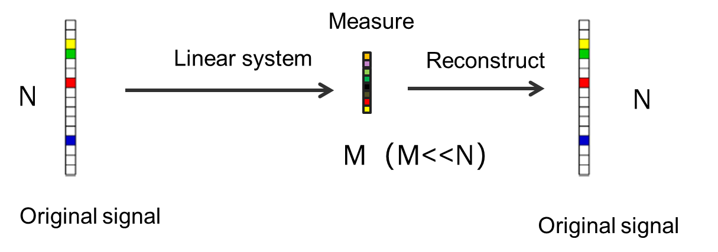
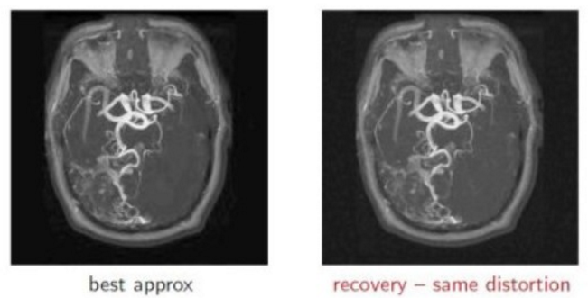
2 Methodology
Compressive sensing
Basic idea(vector case)
Magnetic Resonance Imaging (MRI)

Slide 13
2 Methodology
Compressive sensing
Conditions for valid solution
Matrix-elements are drawn from Gaussian-like distribution.
Matrix is exactly low-rank.
Certain technical conditions for measurement constraint (Restricted isometry property )

Slide 14
2 Methodology
Compressive sensing
Conditions for valid solution
Matrix-elements are drawn from Gaussian-like distribution.
Matrix is exactly low-rank.
Certain technical conditions for measurement constraint (Restricted isometry property )
measurement matrix are “approximately” orthogonal

Slide 15
2 Methodology
Compressive sensing
Conditions for valid solution
Matrix-elements are drawn from Gaussian-like distribution.
Matrix is exactly low-rank.
Certain technical conditions for measurement constraint
❌Real TM elements are nonnegative and often exhibit a highly skewed distribution, where the largest and smallest elements often differ in size by several orders of magnitude.

Slide 16


2 Methodology
Solutions
Sparsity Regularized SVD
This solution aims for a low-rank approximation without strictly enforcing the measurement equations.
Alternating least-squares procedure

Slide 17
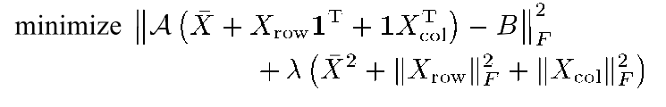
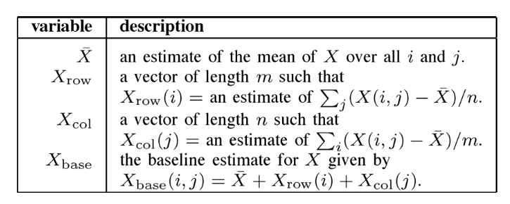
2 Methodology
Other solutions
Low-rank approximation algorithms (global structure)
Baseline approximation
Element-wise mean
Column-wise mean
Row-wise mean

Slide 18
2 Methodology
Other solutions
Low-rank approximation algorithms
Baseline approximation
SRSVD-based
None-negative matrix factorization

Slide 19
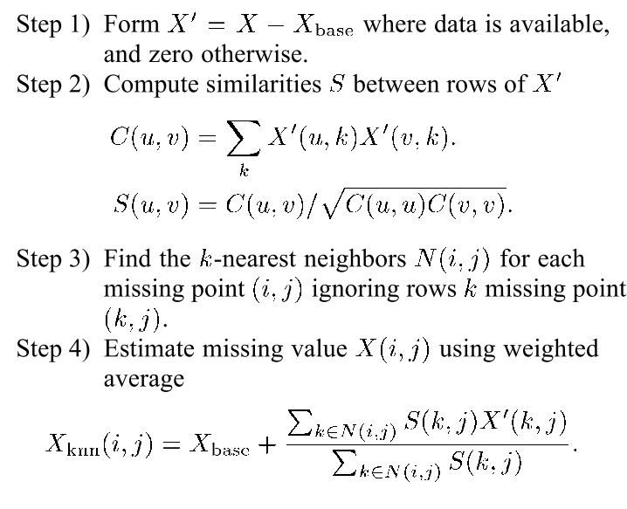
2 Methodology
Solutions
Local Interpolation Algorithms
K-nearest neighborhood (targets local structure)
Design similarity metric since the order of row makes no sense.
Temporal dimension presents stronger similarity according to the study

Slide 20
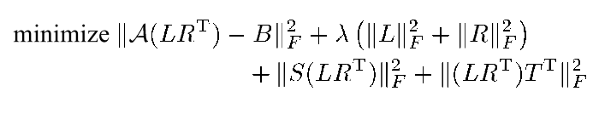
2 Methodology
Proposed solutions
Spatial-temporal compressive sensing
Sparsity Regularized Matrix Factorization

Slide 21
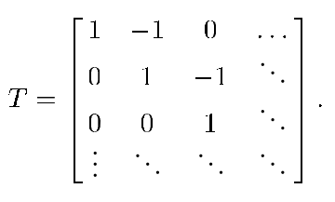
2 Methodology
Proposed solutions
Spatial-temporal compressive sensing
Sparsity Regularized Matrix Factorization
Adjacent points in time are similar

Slide 22


2 Methodology
Proposed solutions
Spatial-temporal compressive sensing
Sparsity Regularized Matrix Factorization
Baseline approximation
$$X$$

Slide 23

2 Methodology
Proposed solutions
Spatial-temporal compressive sensing
Sparsity Regularized Matrix Factorization
$$X_{i,:}$$
Baseline approximation
$$X$$

Slide 24



2 Methodology
Proposed solutions
Spatial-temporal compressive sensing
Sparsity Regularized Matrix Factorization
$$X_{i,:}$$
$$X_{j_{1},:}$$
Find k nearest row for $X_{i,:}$
$$X_{j_{k},:}$$
Baseline approximation
$$X$$

Slide 25


2 Methodology
Proposed solutions
Spatial-temporal compressive sensing
Sparsity Regularized Matrix Factorization
$$X_{i,:}$$
$$X_{j_{1},:}$$
Find k nearest row for $X_{i,:}$
$$X_{j_{k},:}$$
Linear regression
Baseline approximation
$$X$$
Use the weight

Slide 26
2 Methodology
Proposed solutions
Spatial-temporal compressive sensing
Sparsity Regularized Matrix Factorization
Note: scale parameter to avoid overshadow during optimization

Slide 27
2 Methodology
Proposed solutions
Spatial-temporal compressive sensing
Combine global and local methods
Small amount of missing: KNN is better
Large amount of missing: SRMF is better

Slide 28

2 Methodology
Proposed solutions
Spatial-temporal compressive sensing
Combine global and local methods
Small amount of missing: KNN is better
Large amount of missing: SRMF is better
$$X(i,j)$$

Slide 29





2 Methodology
Proposed solutions
Spatial-temporal compressive sensing
Combine global and local methods
Small amount of missing: KNN is better
Large amount of missing: SRMF is better
When the neighbors of missing data also miss, then only use SRMF estimation
$$⋯$$
$$⋯$$
$$X(i,j−3)$$
$$X(i,j+3)$$
$$X_{SRMF}(i,j)$$

Slide 30
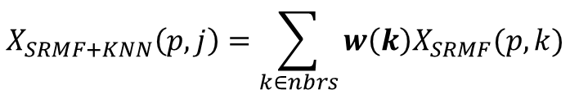

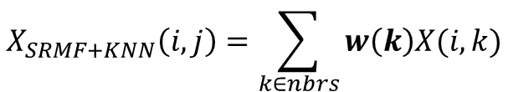
2 Methodology
Proposed solutions
Spatial-temporal compressive sensing
Combine global and local methods
Small amount of missing: KNN is better
Large amount of missing: SRMF is better
Otherwise, hybrid method comes
$$⋯$$
$$⋯$$
$$X(i,j−3)$$
$$X(i,j)$$
$$X(i,j+3)$$
Find temporal relation using approximation from SRMF
Use the weight and observed value for interpolation
$$X_{SRMF+KNN}\left(p,j\right)=\sum_{k∈nbrs}{w\left(k\right)X_{SRMF}(p,k)}$$
$$X_{SRMF+KNN}\left(i,j\right)=\sum_{k∈nbrs}{w\left(k\right)X(i,k)}$$
$$p=1,…n$$

Slide 31
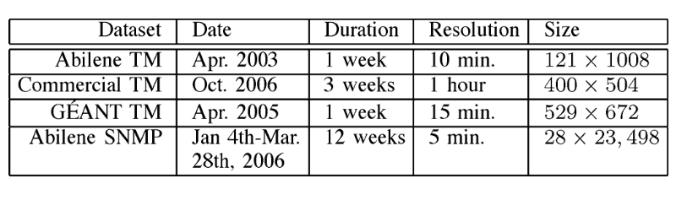
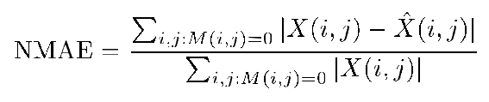
3 Empirical study
Dataset
Normalized mean absolute error

Slide 32
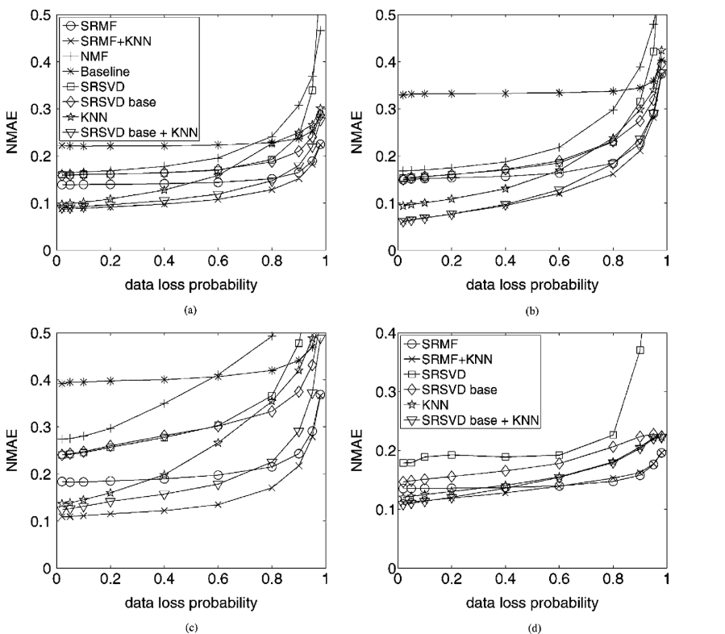
3 Empirical study
Missing value recovery (data losses rate 0.02~0.98)
Hybrid methods are better than individual one.
Performance of KNN shrink quickly as data losses become heavier.
Smaller number of rows allows a lower-rank approximation to fit the data better.

Slide 33
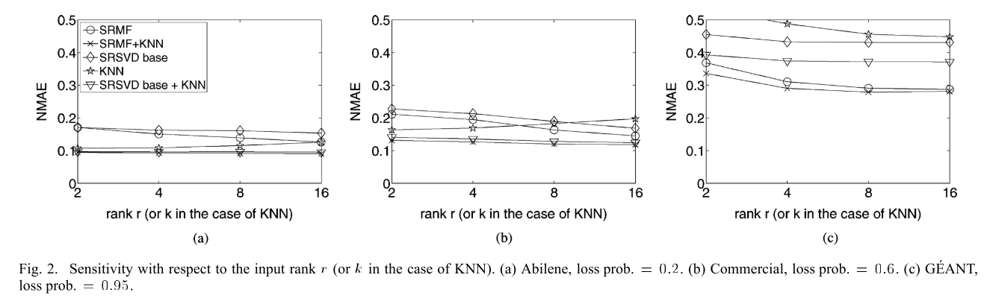
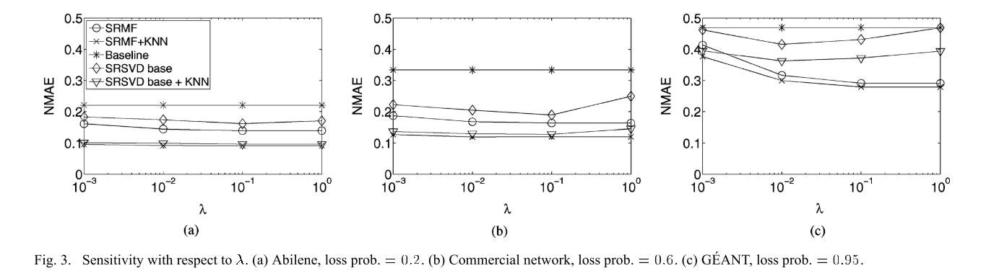
3 Empirical study
Missing value recovery
SRMF+KNN is the most insensitive

Slide 34
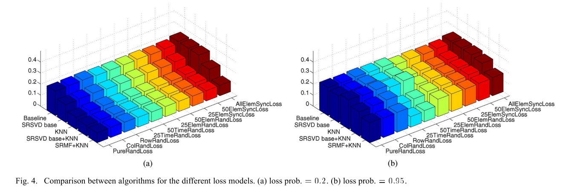
3 Empirical study
Missing value recovery
xxElemsyncLoss : Select xx% rows and select column with a probability p. The Lost data comes from the intersection of the selected rows and columns.
RowRandLoss: Remove a set of rows randomly.
ColRandLoss: Remove a set of columns randomly.

Slide 35
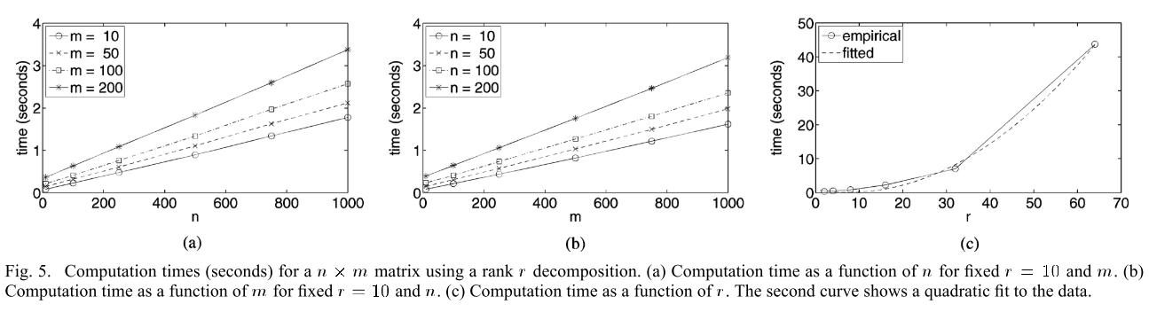
3 Empirical study
Missing value recovery
Computation time
Computation time as a quadratic function of rank

Slide 36
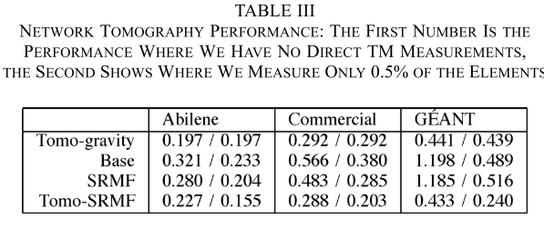
3 Empirical study
Further applications
Tomography
Infer TM from link-load measurements (100% data loss)
Information from Measurement
Information from observed values.
Regularization using KL divergence between gravity model and measurements
Notes:
Do what based what

Slide 37
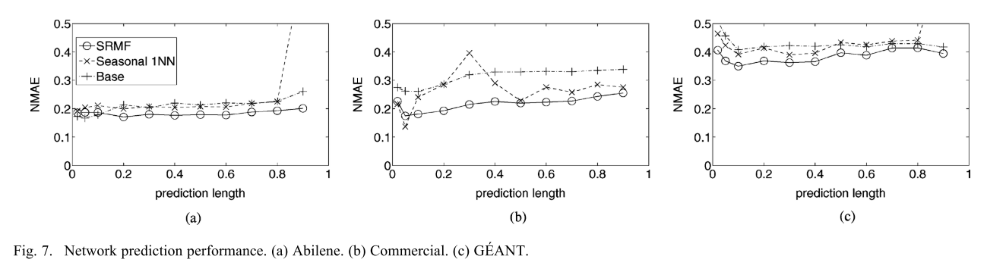
3 Empirical study
Further applications
Prediction
Based on information 24-h ago

Slide 38
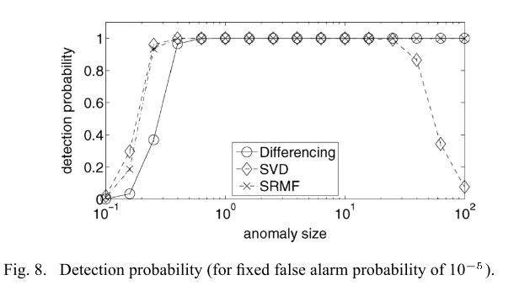
3 Empirical study
Further applications
Anomaly detection
SVD, SRMF
Compare result with the actual traffic. And large difference indicates anomalies.(the threshold is chosen empirically)
Differencing
Directly highlight the sparks on temporal dimension
Spike size
Notes:
The value of the spike is a vector of Gaussian random variables (in each element of the TM)

Slide 39
Thank you for listening !

